Slide 1
Department of Mathematics and Natural Science
CHE 101: Introduction to Chemistry
Lecturer: Afsana Tasnim Oshin
Lecture 5
Content: Rate and rate law; factors that influence the reaction rate

Slide 2
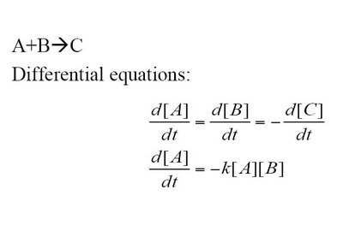
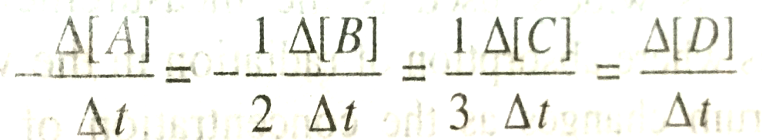
Rate of reaction
The rate of reaction is defined as the decrease in molar concentration of the reactant or increase in molar concentration of the product per unit time.
Or it could be define as the amount of reactant used up or the amount of product formed per unit time.
Lets consider a simple reaction, A B
As the reaction proceed, concentration of A decreases whereas, concentration of B increases.
So the rate of reaction is equal to the rate of disappearance of A, which is equal to the rate of appearance of B.
Rate of reaction = - = +
For the reaction, A + 2B 3C + D
Rate of reaction =

Slide 3
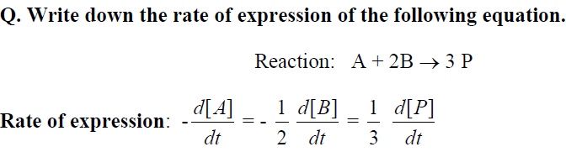
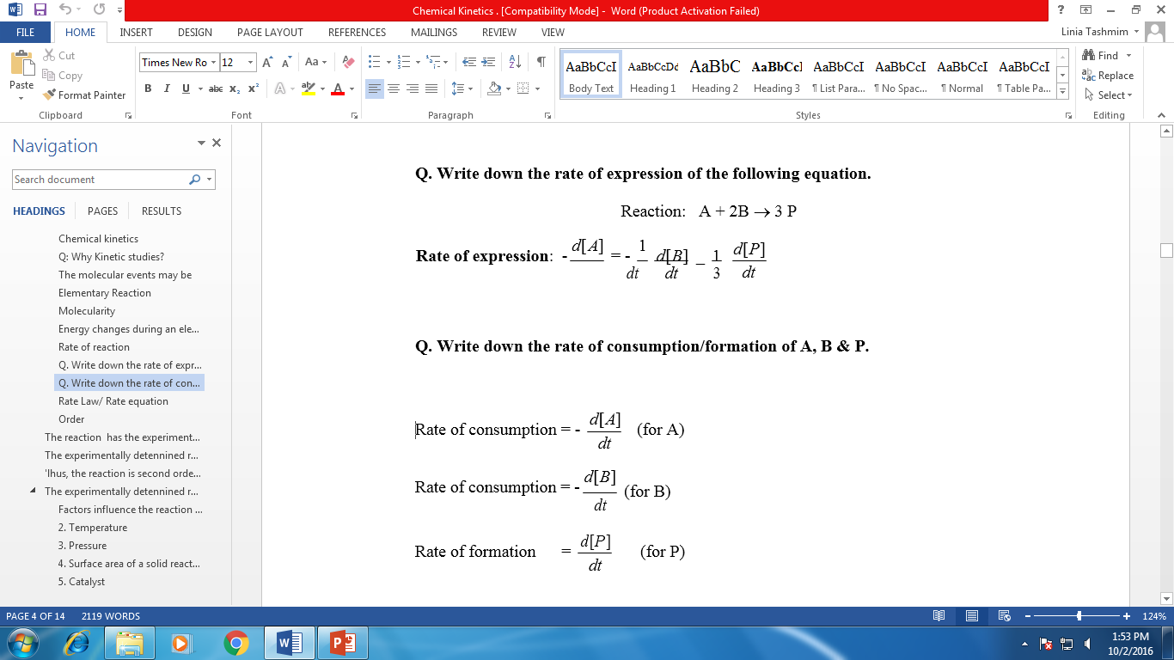

Slide 4
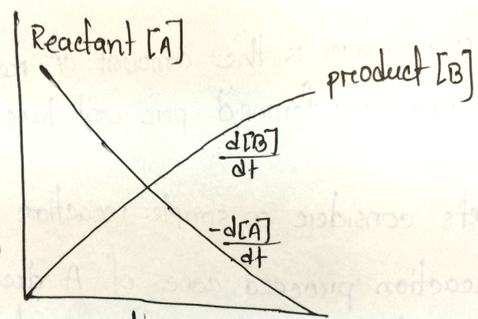
Problem: If the concentration of reactant A, in a reaction is 0.20 mol L⁻¹ at time 15 seconds after the start of the reaction and the concentration is 0.12 mol L⁻¹ after 75 seconds from the start, then calculate the rate of the reaction.
Solution: Here Δ[A] is (0.20 – 0.12) = 0.08 mol L⁻¹ and Δt is (75 – 15) = 60 seconds.
Hence rate of the reaction is = = 0.08 mol L⁻¹/ 60 seconds
= 1.33 X 10-3 mol L⁻¹ s⁻¹
How could we determine the rate of a reaction?
Ans: In order to determine the rate we have to determine the concentration as a function of time. Concentration can not be directly measured. That’s why we measure a parameter (e.g: refractive index, absorbance etc.) which is propotional to the concentration.
conc.
(mol L-1)
time
Fig: concentration of [A] and [B] at different time

Slide 5
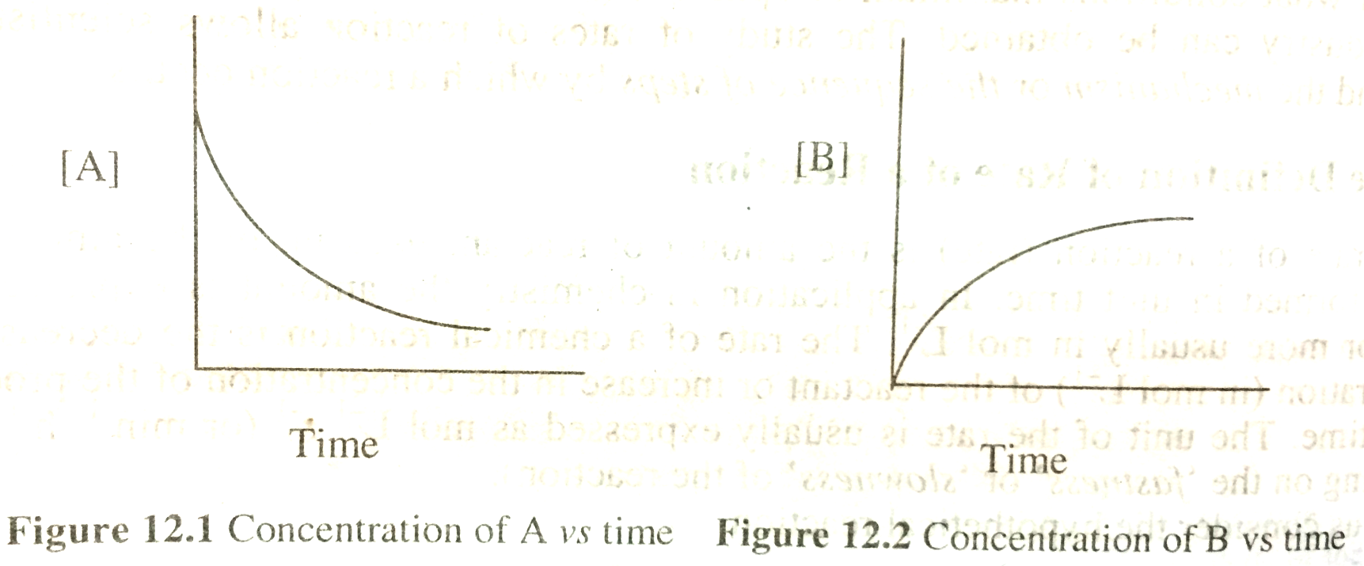
Concentration vs time profile for the reaction, A B

Slide 6
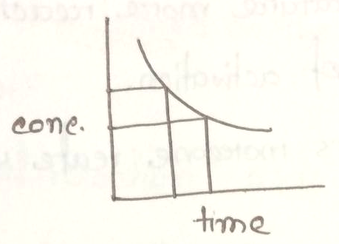
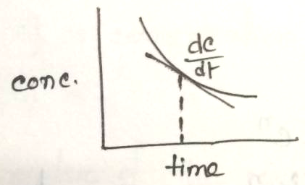
Rate of reaction is of three type
Initial rate
Average rate
Instantaneous rate
Initial rate
Initial rate is the rate at the beginning of the reaction which can’t be determined experimentally
Average rate
If we measure the change in concentration over a period of time, then the rate determined is called the average rate of reaction.
Average rate means the rate between two points in conc. vs time curve.
Instantaneous rate
The rate at particular instance or particular point is called instantaneous rate.

Slide 7
Factors affecting rate of reaction
Concentration
Pressure (in case of gases)
Temperature of reaction
Catalyst
Light (in some cases)
Surface area of solid reactant or catalyst

Slide 8
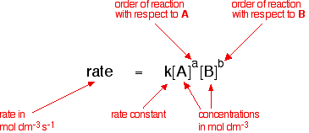
The rate law: Dependence of rate on concentraion
An expression which shows that how the reaction is related to the concentration is called rate law or the rate equation.
According to the law,
For the reaction, aA + bB → xD + yE
In other words, rate law is an equation that is used to predict the concentration of the reactants and products at any time after starting the reaction.

Slide 9
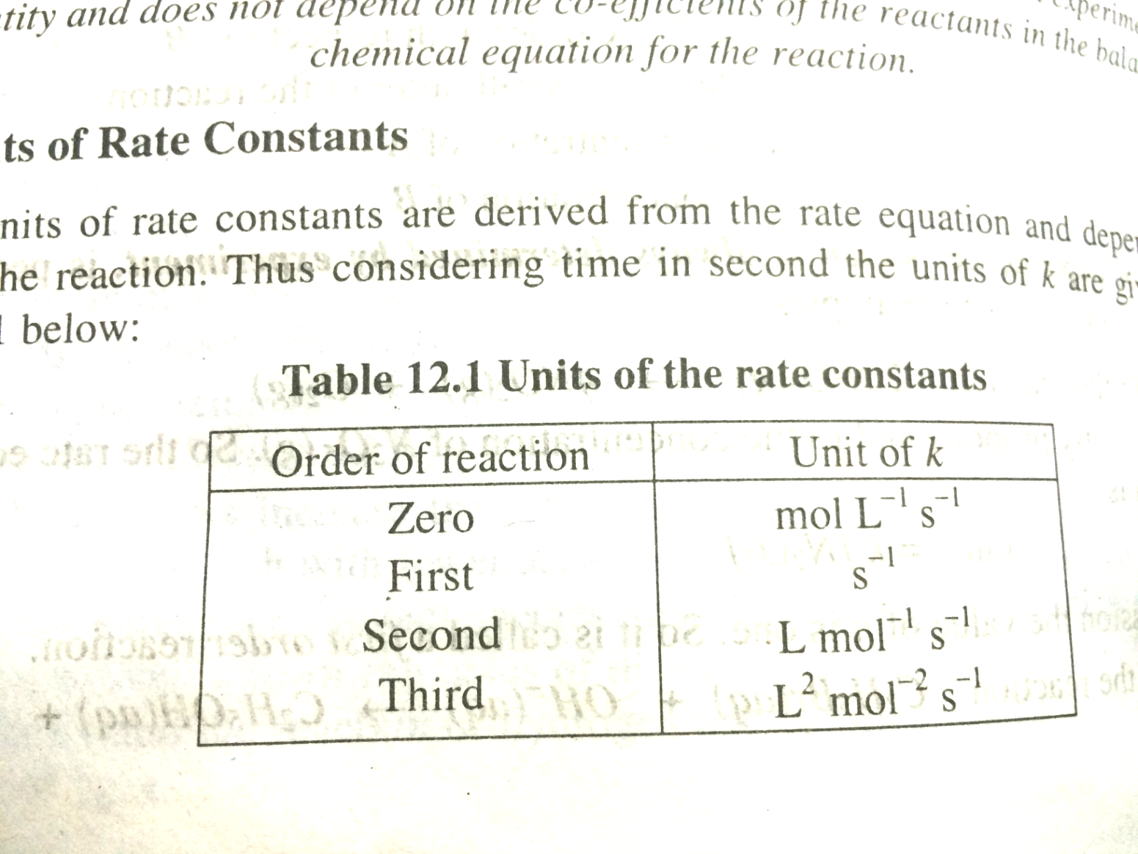
Rate constant, k
The rate constant, k is defined as the proportionality constant between the rate and the concentration term (concentration with its power).
Units of rate constant varies with values of ‘n’ (order of the reaction)

Slide 10
Order of a reaction (n)
The order of a reaction can be defined as the power to which the concentration is to be raised in order to make the concentration term proportional to the rate.
So it may be defined as the sum of power of concentration in the rate law.
In a general reaction, A + B product
rate = k [A]^{m} [B]^{n} or k C_{A}^{m} C_{B}^{n}
where, m = order with respect to A
n = order with respect to B
k = rate constant
C_{A} or [A] is concentration of A
C_{B} or [B] is concentration with respect to B
Overall order of the reaction = m + n
e.g. 2NO2(g) + F2(g) → 2NO2F(g)
Rate = k[NO2][F2] (experimentally determined)
The reaction is first order with respect to the NO2.
Similarly, the reaction is first order with respect to F2.
Overall order = 1+1 = 2
Possible values of n: 0,1,2,3, 3/2, ½
3/2 and 1/2 is possible for gas phase reaction only
Third order reaction is very rare because 3 molecules are very difficult to collide at the same time with same stereochemistry.

Slide 11
Why the molecularity of each elementary step of the reaction is the same as the order of the reaction?
Ans: Because for an elementary step of the reaction the reaction rate is proportional to the concentration of each reactant species in the step.
For example a bimolecular step will have second order kinetics.
Difference between order and molecularity
Order | Molecularity
1. It is the sum of the powers of the concentration terms in the rate law expression | 1. It is the number of reacting species undergoing simultaneous collision in the elementary or simple reaction
2. It is an experimentally determined value | 2. It is a theoretical value
3. It can have fractional value | 3. It is always a whole number
4. It can assume zero value | 4. It can not have zero value
5. Order of the reaction can change with collisions such as pressure, temperature, concentration etc | 5. Molecularity is invariant for a chemical equation

Slide 12
Collision theory of reaction rate
According to collision theory there are three pre-conditions to take place a reaction. They are:
1st condition: In order for a chemical reaction to take place, the reactants molecules must collide.
2nd condition: Collision between the molecules must be occurred in such a way so that they can achieve minimum amount of energy to occur the reaction.
3rd condition: The molecules must also collide in the right orientation.

